Slide 1
Bell Work
What are some physical features of a toddler?

Slide 2
Child Development: Unit 5 Preschool
Preschool Physical Development

Slide 3
Unit 2, Quiz #2
1. Of the following, which are often a toddler’s FIRST words:
Animal sounds like “MOO”
Verbs like “RUN”
Adjectives like “HOT”
Nouns like “APPLE”

Slide 4
Unit 2, Quiz #2
2. Parents can encourage language development by:
A. Being a good language model for the toddler
B. Talking baby talk to the toddler
C. Ignoring the child when they talk
D. Correct and punish the child when they make language mistakes

Slide 5
Unit 2, Quiz #2
3. If your child receives a difficult puzzle for their 2nd birthday, you should:
A. Make the child play with it so the person who gave the gift knows it is appreciated
B. Do the puzzle for the child
C. Let the child play with the puzzle, but don’t force them to put it together correctly
D. Throw the puzzle away since it is too hard

Slide 6
Unit 2, Quiz #2
4. A good toy for toddler make-believe play is:
A. Pull toy C. Rattle
B. Toy phone D. Book
5. A child learning new concepts that do not really make sense to them is in which stage of Piaget
A. Sensorimotor
B. Autonomy vs. Shame and Doubt
C. Pre-operational
D. Formal operational

Slide 7
Child Development
Teddi
Jenny J.
Madi S.
Taylor R.
Madi
Charee
Keresha
5B Tuesday Reality Baby
Children’s Book

Slide 8
Child Development
Sina
Amelia
Makayla
Haley
Lynsee
Haley
Lynsee
Melanie
Shae
6B Tuesday Reality Baby
Children’s Book

Slide 9
Preschool Physical Development
T
1.
Children ages 3-5 are often called preschoolers.
Growth in the preschool years. The average yearly increase is 2 ½ to 3 inches.
Most children about 4-5 pounds per year during the preschool age.
Size of preschoolers vary due to individual growth patterns.
During this age, the body becomes straighter and slimmer, legs continue to grow rapidly, their neck gets longer, and the torso flattens and widens. They are losing the baby appearance and looking more like a big kid.
Q1
F
2.
slows down
Speeds up
F
3.
gain
lose
T
4.
T
5.

Slide 11
Q2
F
6.
Because of their changing proportion, the preschooler’s balance and coordination
which affects their movements.
Stronger, smoother, and more coordinated gross motor skills allow a preschooler to
Fine motor skills are controlled and refined which make easier.
Improved hand-eye coordination and manual dexterity make for better use of the preschooler’s fingers and hands. Continue providing me with toys, activities and materials that will develop these skills.
improves
worsens
F
7.
Q3
color, cut and paste.
__________________________.
F
8.
Hokey pokey
running, jumping, and throwing
__________________________
T
9.

Slide 12
List major physical milestones during the preschool years: GROSS and FINE
3 Year Old
Gross Motor
Runs well
Marches
Stands on one foot briefly
Rides Tricycle
Fine Motor
Feeds themselves well
Shoes and stockings
Unbutton and buttons
4 Year Old
Gross Motor
Skips on one foot
Wash face
Dress Self
Throws ball overhand
Fine Motor
Draws “Man
Cuts with scissors- not well

Slide 13
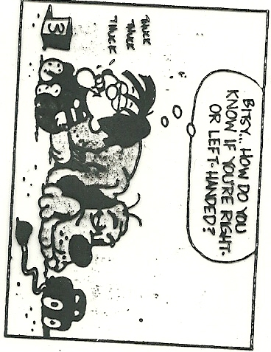
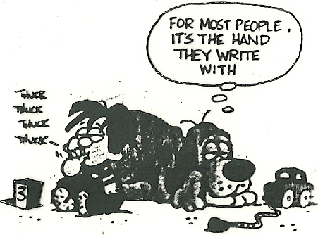
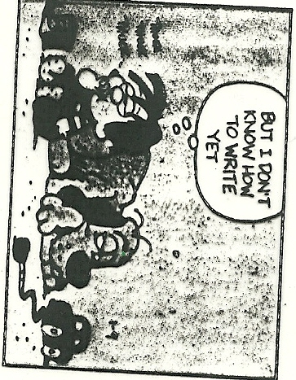
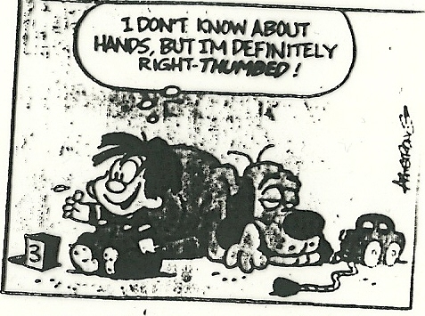
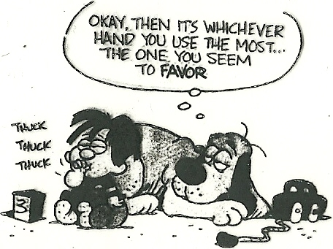

Slide 14
Q4
Most children by age 5 show a definite hand preference and will consistently use either their right or left hand. This begins to show itself around age 2.
T
10.


Slide 15
Finger trick
Q5
Children of this age are known for their activity level and energy.
This is the time a preschooler
developing both their
small and large motor skills.
Younger preschoolers practice developing their motor skills by participating in the activity or task again and again, over and over.
F
11.
high
low
F
12.
lacks interest in
practices
T
13.

Slide 16
Q6
T
14.
The amount of food a preschooler needs depends on their height and weight, their temperament, and the level of activity.
Remember that children grow from near to far, head to foot, and at their own rate, but if a caregiver suspects a weight problem (too skinny or overweight) see their doctor.
Children do better with
5 or 6 small meals and snacks a day.
The child’s hand size indicates the amount of food that they should be given.
Provide nutritious meals and teach them about nutrition, like the food guide pyramid, so that they will be healthy and know how to make healthy choices.
The preschooler is always watching your example of nutrition.
F
15.
3 large meals not

Slide 17
Q7
F
16.
Children maintaining cleanliness habits which is great, because poorly acquired habits can continue into adulthood.
Allow a child to try new things on their own and let them know that you are available to help them only if they decide that they need it and ask for it.
have perfected
still need help
T
17.

Slide 18
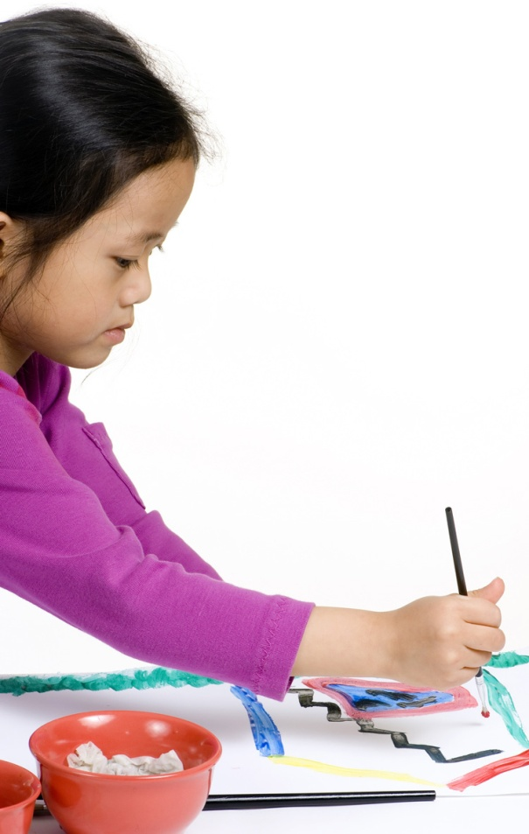
Self-Help Care Skills that a preschooler learns.
How Can a Caregiver Encourage These?
Release control
Provide choices for them
Set them up for successes
Set an example
Let them know that you are here to help if they need it Do it with them not for them
Sing your instructions instead of speak them
Sit Down – London Bridges
Play times over let’s sit down.
Let’s sit down
Let’s sit down
Play times over let’s sit down
All kids fall down.

Slide 19
PARACHUTE TIME!

Slide 20
Preschool Development Stations
Center #1:THUMBIES PICTURE
❶Make 4 thumbprints on the paper – anywhere you like.
❷Using other writing utensils, turn these prints into a picture (flower, reindeer, spider…)
❸Now write a STORY using the 4 thumbprints.
The story needs to have a plot (beginning, middle, and end) and be descriptive.
It needs to be 3-5 paragraphs long with 3-5 sentences in each paragraph. Use correct spelling and grammar.
Center #2: PAPER BAG PUPPET
Using ONE paper bag, some colored paper, and other supplies; create a paper bag puppet.
Center #3:FRECKLE NAMES and LETTERS
❶Hole punch a bunch of colorful dots.
❷Write your name on a piece of paper (remember to use an uppercase letter for the first letter and a lowercase letter for the remaining letters).
❸Outline each letter with glue and sprinkle a handful of hole punches over the paper. Shake off the excess hole punches into the container for somebody else to use later.
❹Only using the glue and hole punches, decorate your name paper
Center #4: POPSICKLE STICK PUZZLE
Using at least 5 sticks, make a puzzle. Lay the popsicle sticks out and draw a large picture that covers all of the sticks. Mix the sticks up and have somebody put your puzzle together.

Slide 21
Center #6: MAGIC PAINTING
Using the white crayons, draw a picture or a design on the white paper. Paint over it with your choice of water color paint. Keep the paint, paint tray, and water cups clean for the next person.
Center #7: PRESCHOOL GAMES (Don’t Spill the Beans, Don’t Break The Ice, Toss Across, Ring Toss)
Choose a game and play it with a friend. Remember to play by the rules and to be a good sport.

